Slide 1
AICTE Microsoft Industry Project
“Hospital Management System”
By
Vishwanath : 2GI18CS188
Under the Guidance of
Prof. Sudha Ayatti
Department of Computer Science and Engineering
KLS, GIT, Belgaum
Academic Year – 2021-22

Slide 2
1. Project Title 2. Motivations 3. GUI Design 4. SRS Document 5. References
Table of Contents

Slide 3
Project Title : Hospital Management System. Problem Statement : To design and develop a system software for proper hospital management using Microsoft Azure platform, React and Spring Boot frameworks.
Project Title

Slide 4
Objective : To help in the management of Hospitals. Challenges : Already many solutions are there to solve the problem but they are not user friendly, they are complex and harder to understand. Our project is user friendly which will help the hospital workers to use the system properly even if they are a newbie and take appropriate decisions.

Slide 5
1 ) To help the hospital workers. 2 ) To learn about software development. 3 ) To contribute in the development of the society.
Motivation for taking up the project

Slide 6

GUI Design

Slide 7

GUI Design

Slide 8
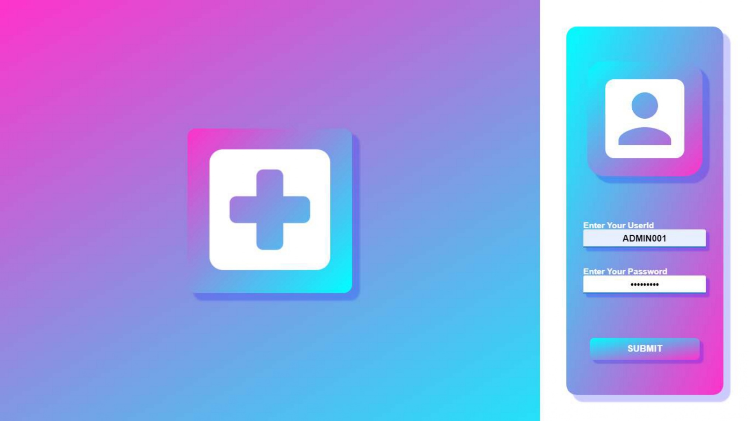
GUI Design

Slide 9
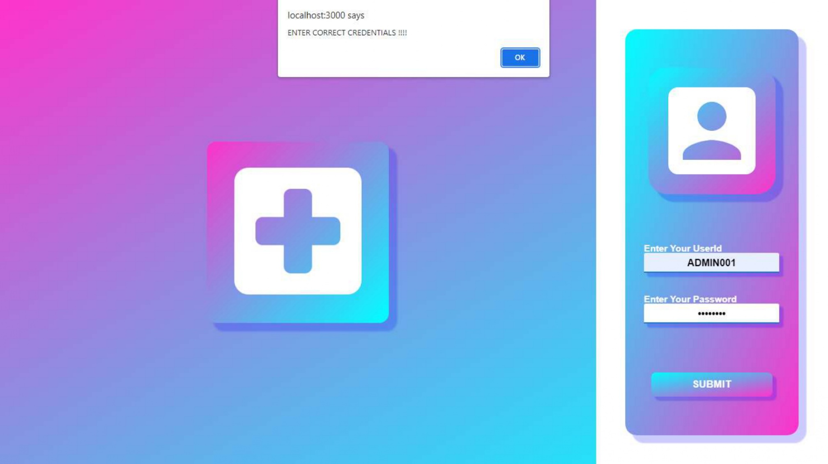
GUI Design

Slide 10
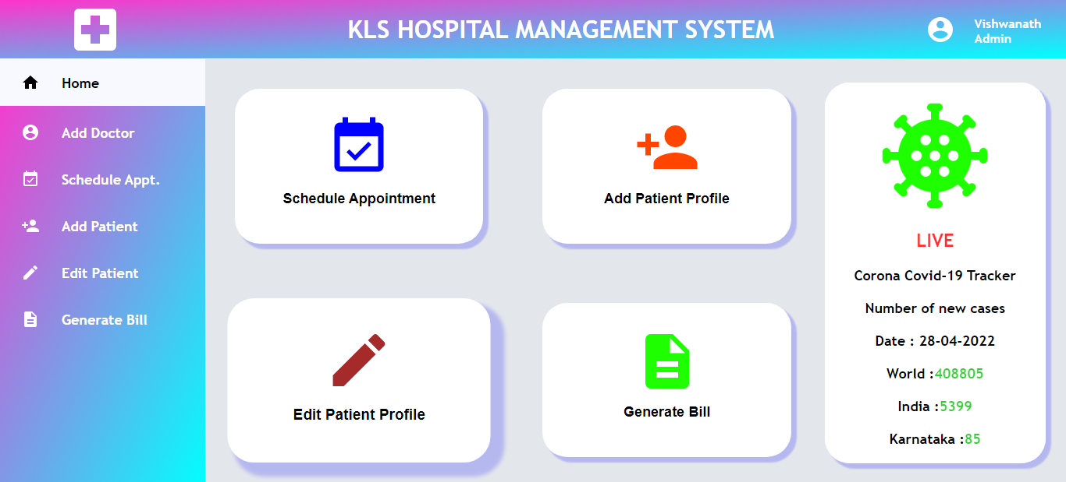
GUI Design

Slide 11
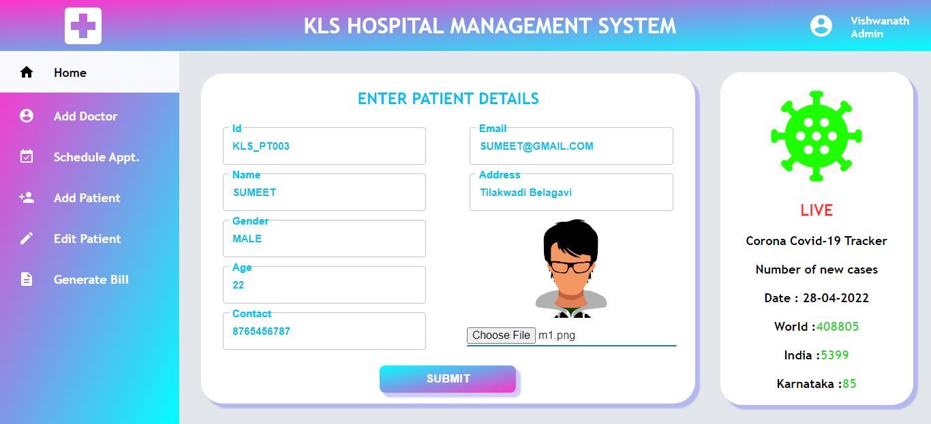
GUI Design

Slide 12
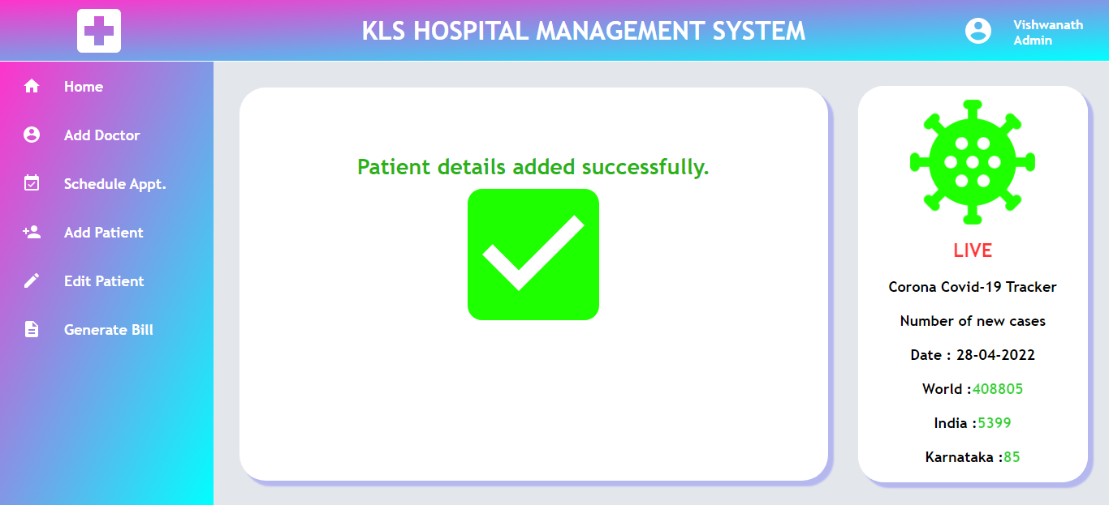
GUI Design

Slide 13
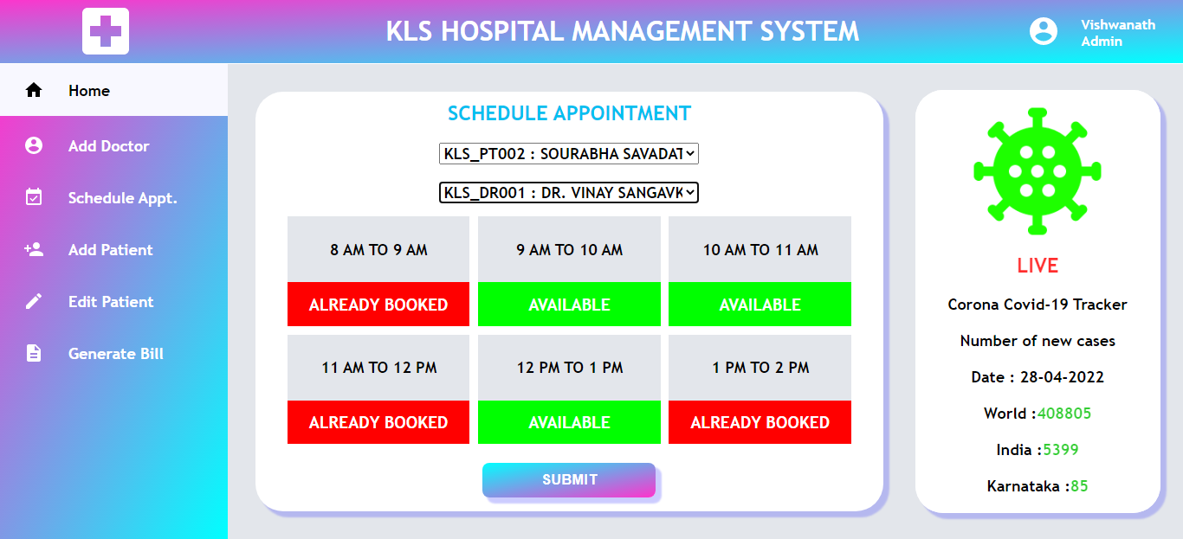
GUI Design

Slide 14
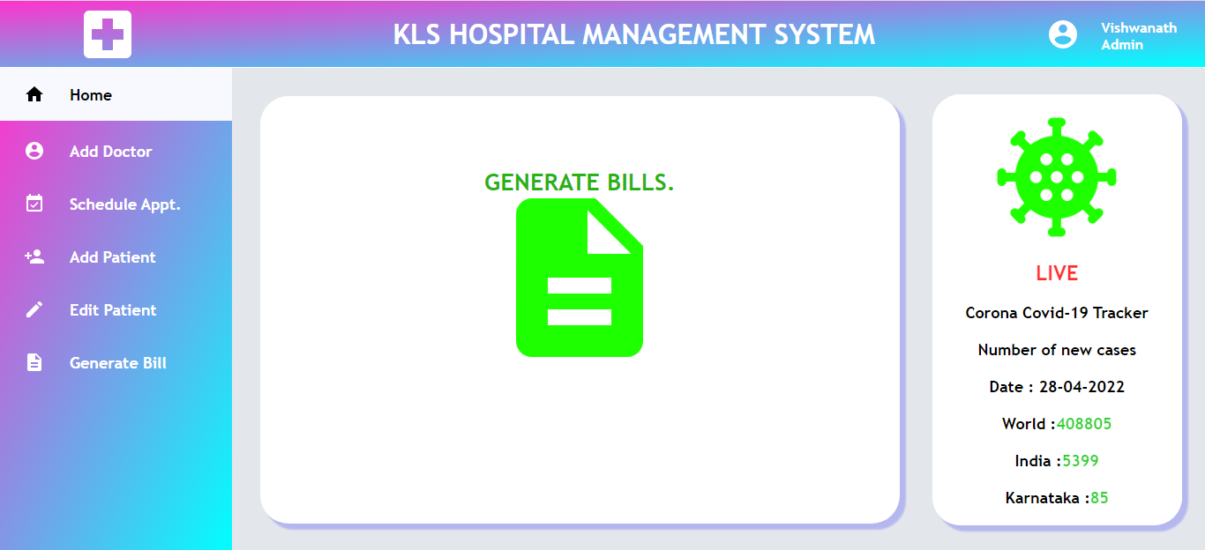
GUI Design

Slide 15


Programming Language (Front-End): React Programming Language (Back-End): Spring-Boot
Software Platforms and Development Tools Identified

Slide 16



Platform: Microsoft Azure Operating System : Windows/Linux/MacOS Development IDE : VS Code
Software Platforms and Development Tools Identified

Slide 17


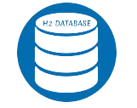
Web Development – For making the front end using React Framework. Java Programming – For making the back end using Spring Boot Framework. Database Management System - For storing the data in Spring Boot H2 database.
Fundamental Subjects/Concepts Used in the Project

Slide 18
1. Problem Statement & Title Finalized - Yes 2. Functional, Non-functional Requirements – Identified Yes 3. Design – Database, Class/Module, GUI Complete 4. Code – Modules Developed Done 5. Future Plan of Action Ready
Project Work Progress

Slide 19
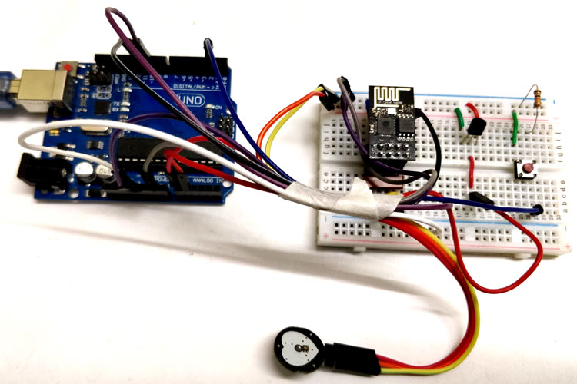
Adding IOT Device for calculating Heart beats and predicting the health using the number of heart beats.
Future Plan of Action

Slide 20
References
https://futurereadytalent.in/
https://spring.io/projects/spring-boot
https://reactjs.org/docs/getting-started.html

Slide 21
LIVE DEMO
PROJECT DEMO LINK : https://delightful-cliff-0e7ed1510.1.azurestaticapps.net

Slide 22
Thank You

